Slide 1
Observer performance aka “ROC analysis”
Dev P. Chakraborty, Ph.D.

Slide 2
Overview of software and online books
Summary of online material:
https://dpc10ster.github.io/ai-froc-research/
Create free GitHub account to access it

Slide 3
Outline
Data collection
ROC curve
Quantification of performance
Analyzing your ROC data

Slide 4
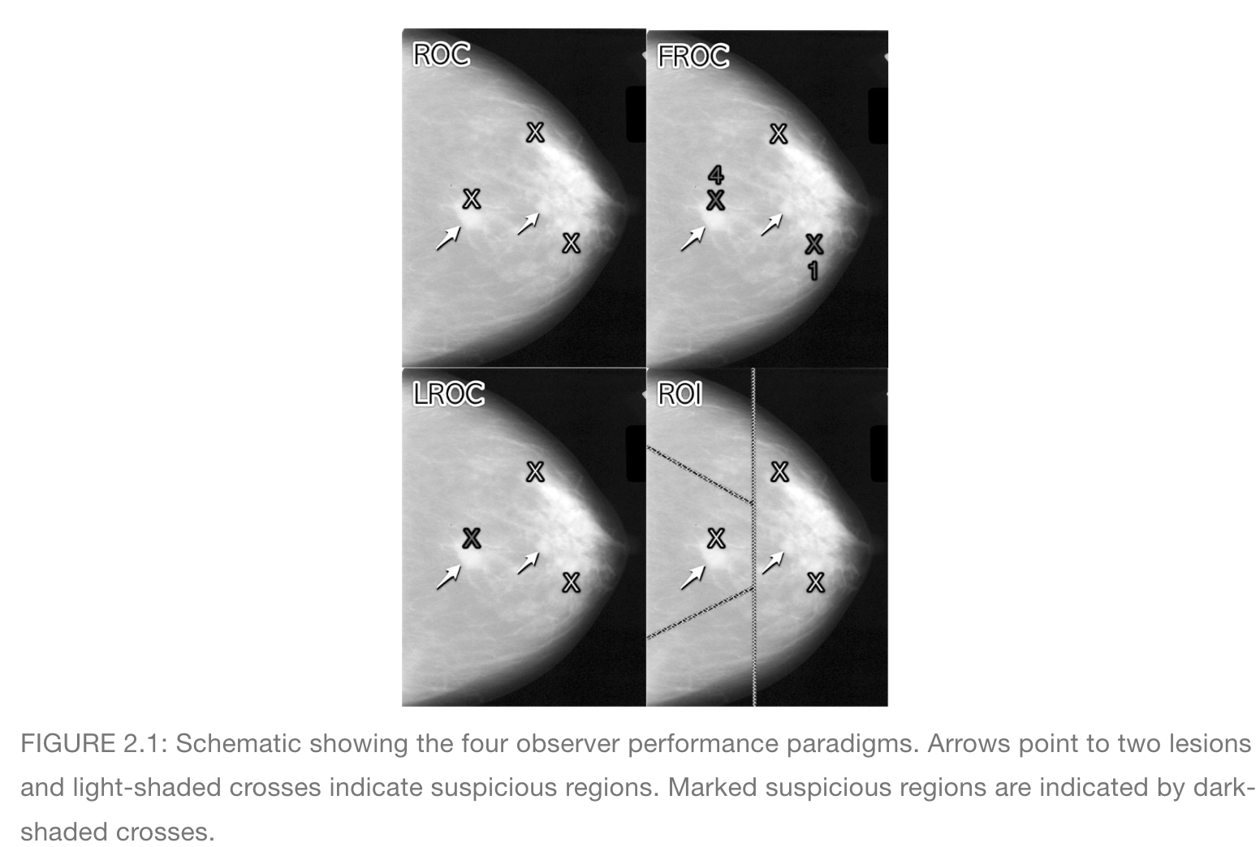
Data Collection

Slide 5
I will focus on the ROC data collection method

Slide 6
Truth vs. perceived Truth (i.e., Decision)

Slide 7
Binary task
Truth T, actual or true disease state of case
T = 1, actually non-diseased case
T = 2, actually diseased case
Decision D, or perceived truth
D = 1, case perceived as non-diseased
D = 2, case perceived as diseased

Slide 8
Binary task ...
Observer shown non-diseased (T = 1) and diseased (T = 2) cases, one at a time
Decision: observer classifies each case as either non-diseased (D = 1) or diseased (D = 2)

Slide 9
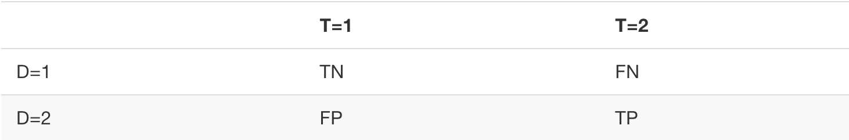
Events
TN = True Negative
FN = False Negative (“miss”)
FP = False Positive (“false alarm”)
TP = True Positive (“hit”)
2 x 2 Table:

Slide 10
Sensitivity and Specificity
P(X|Y) = probability of X given Y
True positive fraction (TPF)
TPF = P(D = 2|T = 2) = Sensitivity
False positive fraction (FPF)
FPF = P(D = 2|T = 1)
Specificity = P(D = 1|T = 1) = 1 – FPF

Slide 11
Meanings
Sensitivity: how good observer is at diagnosing diseased cases
Specificity: how good observer is at diagnosing non-diseased cases

Slide 12
Estimating TPF, FPF
N(X) means number of X
TPF = N(D = 2) / N(T = 2)
FPF = N(D = 2) / N(T = 1)

Slide 13
Decision threshold ζ
Confidence level in decision varies from case to case
An “easy” case appears so obviously non-diseased or diseased that observer has high confidence in decision
In “difficult” case observer’s confidence level is lower

Slide 14
Decision rule
If confidence level > ζ, observer reports case as diseased
Otherwise, case is reported as non-diseased

Slide 15
Decision rule ...
TPF and FPF can be varied by changing ζ
If ζ is increased, both TPF and FPF decrease

Slide 16
ROC curve
Receiver Operating Characteristic
Vary decision threshold ζ
ROC curve is Plot of TPF vs. FPF

Slide 17
Ratings method
Observer rates (i.e., labels) each case according to confidence that it is diseased, e.g.:
1 = very confident non-diseased
2 = somewhat confident non-diseased
3 = ambiguous
4 = somewhat confident diseased
5 = very confident diseased

Slide 18
Ratings method ...
5 ratings are equivalent to simultaneously running 4 binary tasks with thresholds
ζ₁ < ζ₂ < ζ₃ < ζ₄
Yields 4 non-trivial points on ROC curve
Cumulate numbers and divide by appropriate denominator to get operating points on ROC, as in following example

Slide 19
Example dataset
60 non-diseased cases
50 diseased cases
Five-point rating scale
Actual clinical dataset

Slide 20
 | Total | Counts
 |  | 1 | 2 | 3 | 4 | 5
Non-dis. | 60 | 13 | 19 | 8 | 2 | 1
Dis. | 50 | 5 | 6 | 5 | 12 | 22
 |  | Operating points
 |  | ≥5 | ≥4 | ≥3 | ≥2 | ≥1
FPF |  | 0.017 | 0.050 | 0.183 | 0.500 | 1.000
TPF |  | 0.440 | 0.680 | 0.780 | 0.900 | 1.000
1/60 = 0.017; 3/60 = 0.05; 11/60 = 0.183; 30/60 = 0.5; 60/60 = 1
22/50 = 0.44; 34/50 = 0.68; 39/50 = 0.78; 45/50 = 0.9; 50/50 = 1

Slide 21
ζ is decision threshold
High ζ
Low ζ
2+3+4+5
3+4+5
4+5
5

Slide 22
Important point!
Ratings are ordered labels, not numbers; for example, a 5-point rating scale could be:
A = very confident non-diseased
B = somewhat confident non-diseased
C = ambiguous
D = somewhat confident diseased
E = very confident diseased
This yields identical ROC operating points as 1 – 5 scale

Slide 23
Implication for analysis
Can only use ordering information, e.g., A < B < C < D < E
Arithmetic operations, e.g., averaging the ratings, etc., are forbidden !!

Slide 24
AUC – area under curve
Computed from ratings
Empirical AUC
Analytical AUC

Slide 25
Empirical vs. analytical AUCs
Empirical (observed) AUC
Connect adjacent points with straight lines: this defines empirical ROC “curve”
AUC = trapezoidal area under empirical ROC “curve”
Analytical AUC
Fit ratings data to a model that predicts ROC curves
AUC = area under predicted ROC curve

Slide 26
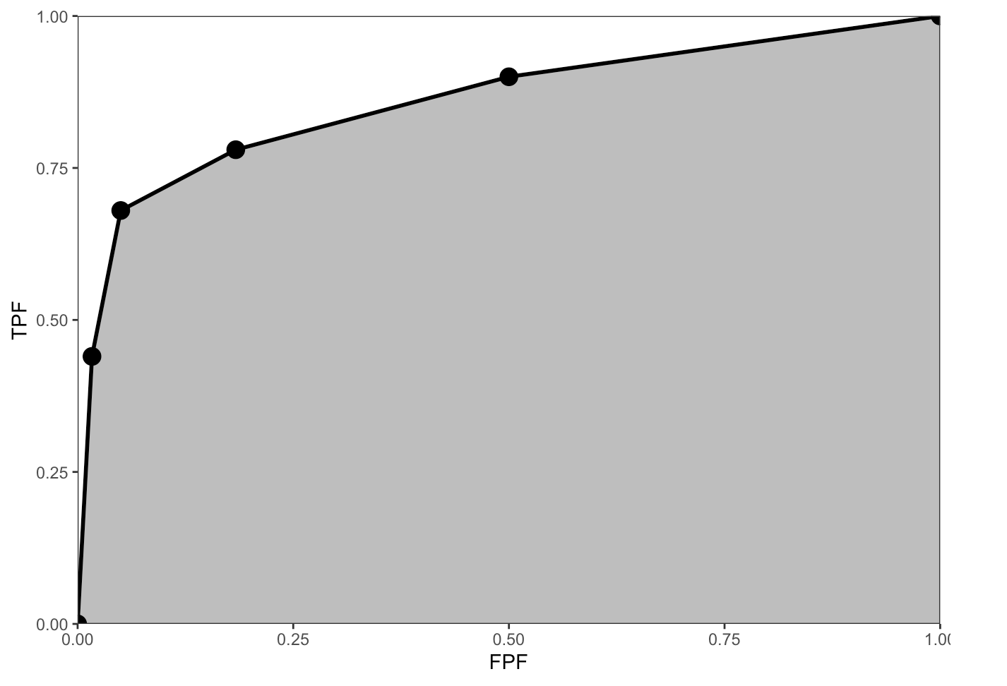
Empirical AUC

Slide 27
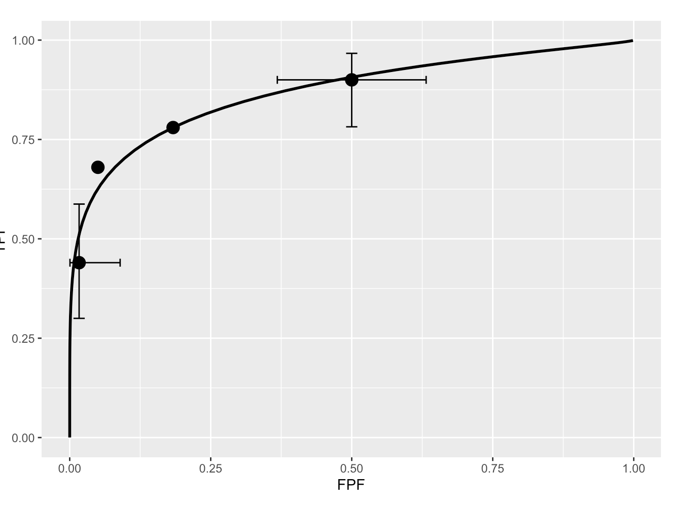
Analytical AUC

Slide 28
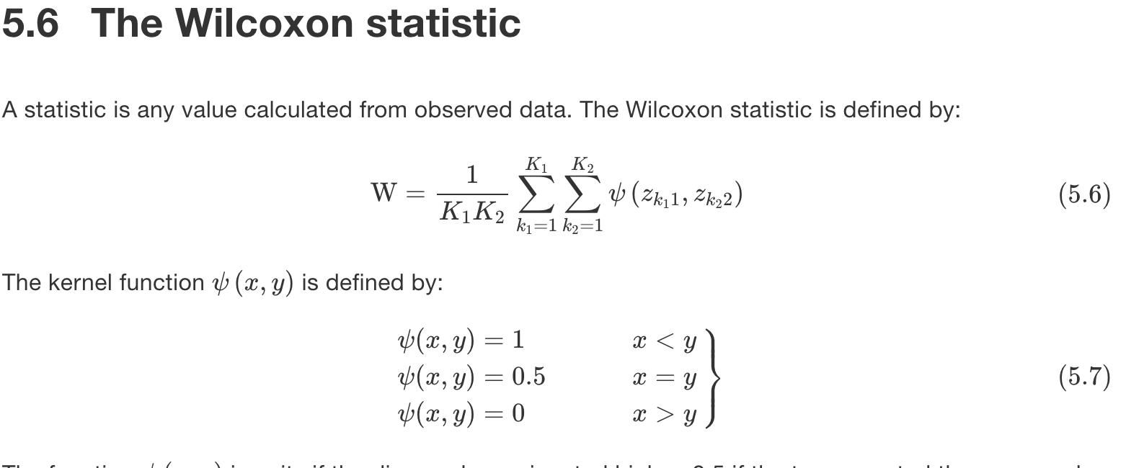
K₁ = N(non-diseased cases), indexed by k₁
K₂ = N(diseased cases), indexed by k₂
The z’s are the ratings; subscripted 1 for non-diseased and 2 for diseased
Note: only ordering information is used in calculating W

Slide 29
Theorem
W = Empirical AUC

Slide 30
Comments
Use empirical AUC, not analytical
W = empirical AUC correspondence is used in almost all current approaches to analyzing ROC data
(Analytical AUC is not equivalent to W)

Slide 31
Meaning of empirical AUC (or W)
Classification accuracy between non-diseased and diseased cases
0 <= AUC <= 1
AUC = 0: “worst” performance
AUC = 0.5: random performance
AUC = 1: best performance

Slide 32
Advantage of using AUC
AUC is decision threshold independent
An important study:
Beam et al 1996
108 radiologist observers
45 diseased and 34 non-diseased cases
Binary classification task

Slide 33
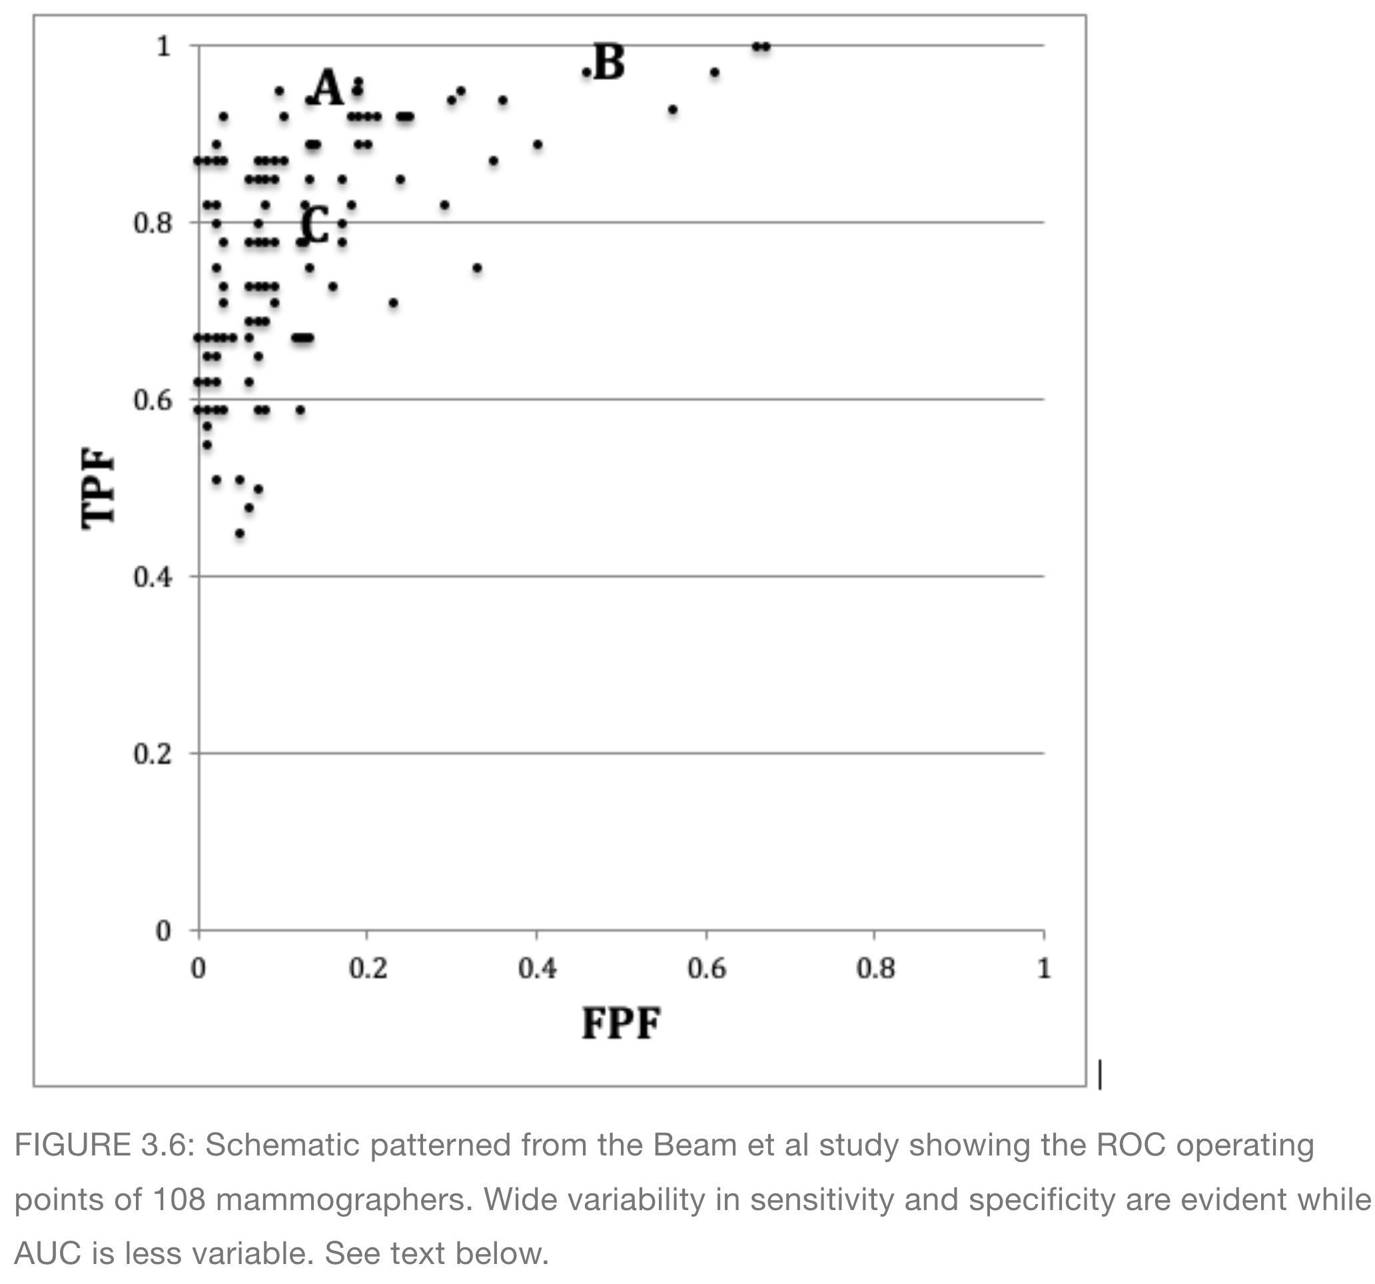

Slide 34
Types of ROC studies and related questions
Single observer one-modality
One observer interprets cases in one modality
Is single-observer AUC different from a specified value?
Multiple-observer one-modality
Several observers interpret same cases in one modality
Is observer-averaged AUC different from a specified value?
Multiple-observer multiple-modalities
Several observers interpret same cases in multiple modalities
Is observer-averaged AUC different between the modalities?

Slide 35
AUC confidence interval
CI(AUC) = confidence interval of AUC
σ(AUC) = standard deviation of AUC
95% CI(AUC)
(AUC - 2 σ(AUC), AUC + 2 σ(AUC))
If specified value is outside CI, it is different from observed AUC at 5% significance level
Estimating σ(AUC) requires statistics

Slide 36
Unit normal distribution
https://dpc10ster.github.io/RJafrocRocBook/binary-task-model.html#binary-task-model-normal-distribution
Reason for factor of 2

Slide 37
Comments on single-observer
Results apply to specific observer and cases in the study
Need to account for sampling effects:
Observer is sampled from observer population
Cases are sampled from case population
If sampling is accounted for results will apply to more general situations

Slide 38
Comparing 2 modalities
Determine AUC for each modality and each observer, and associated variabilities
Statistical analysis
Determines significance of observer-averaged difference (Δ AUC) in AUC between modalities
Significance is assessed by p-value

Slide 39
p-value
Probability Δ AUC or larger could occur by chance given Δ AUC_{true} = 0
If p ≤ α (usually α = 5%) conclude AUCs are different at α-significance level

Slide 40
Outcome of an ROC study
AUC difference is significant (if p ≤ α ) or not significant (if p > α )
If p > α cannot claim modalities have "identical" or "similar" performance

Slide 41
Getting started with software
Download R
https://cran.r-project.org/
Download RStudio
https://posit.co/downloads/

Slide 42
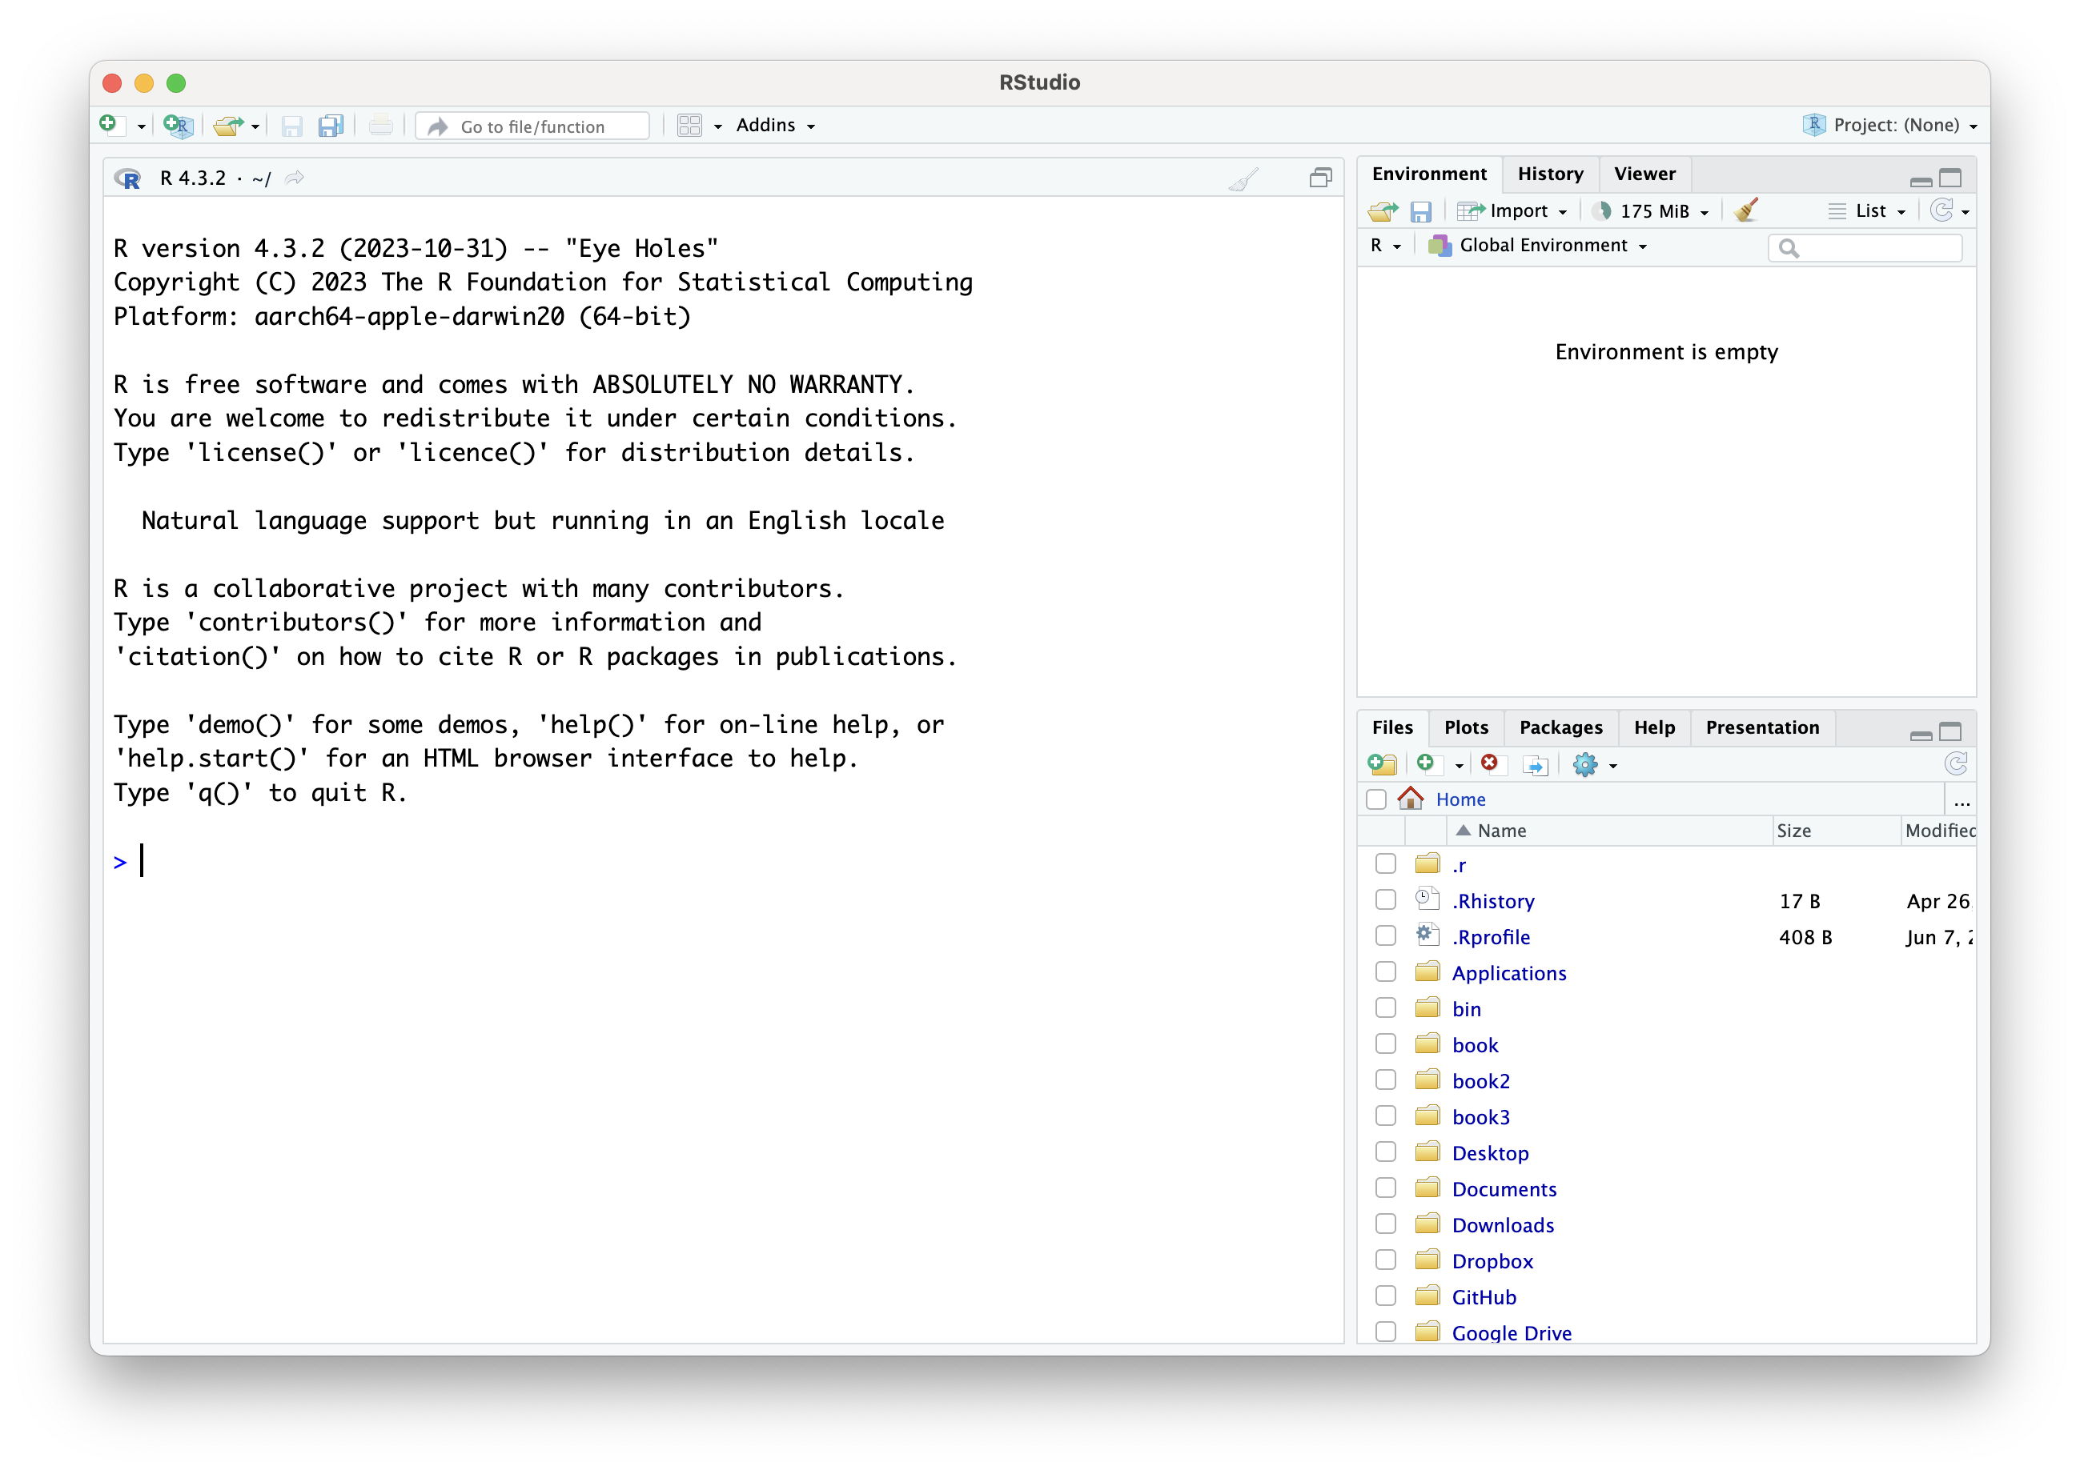
Open RStudio
Create project file

Slide 43
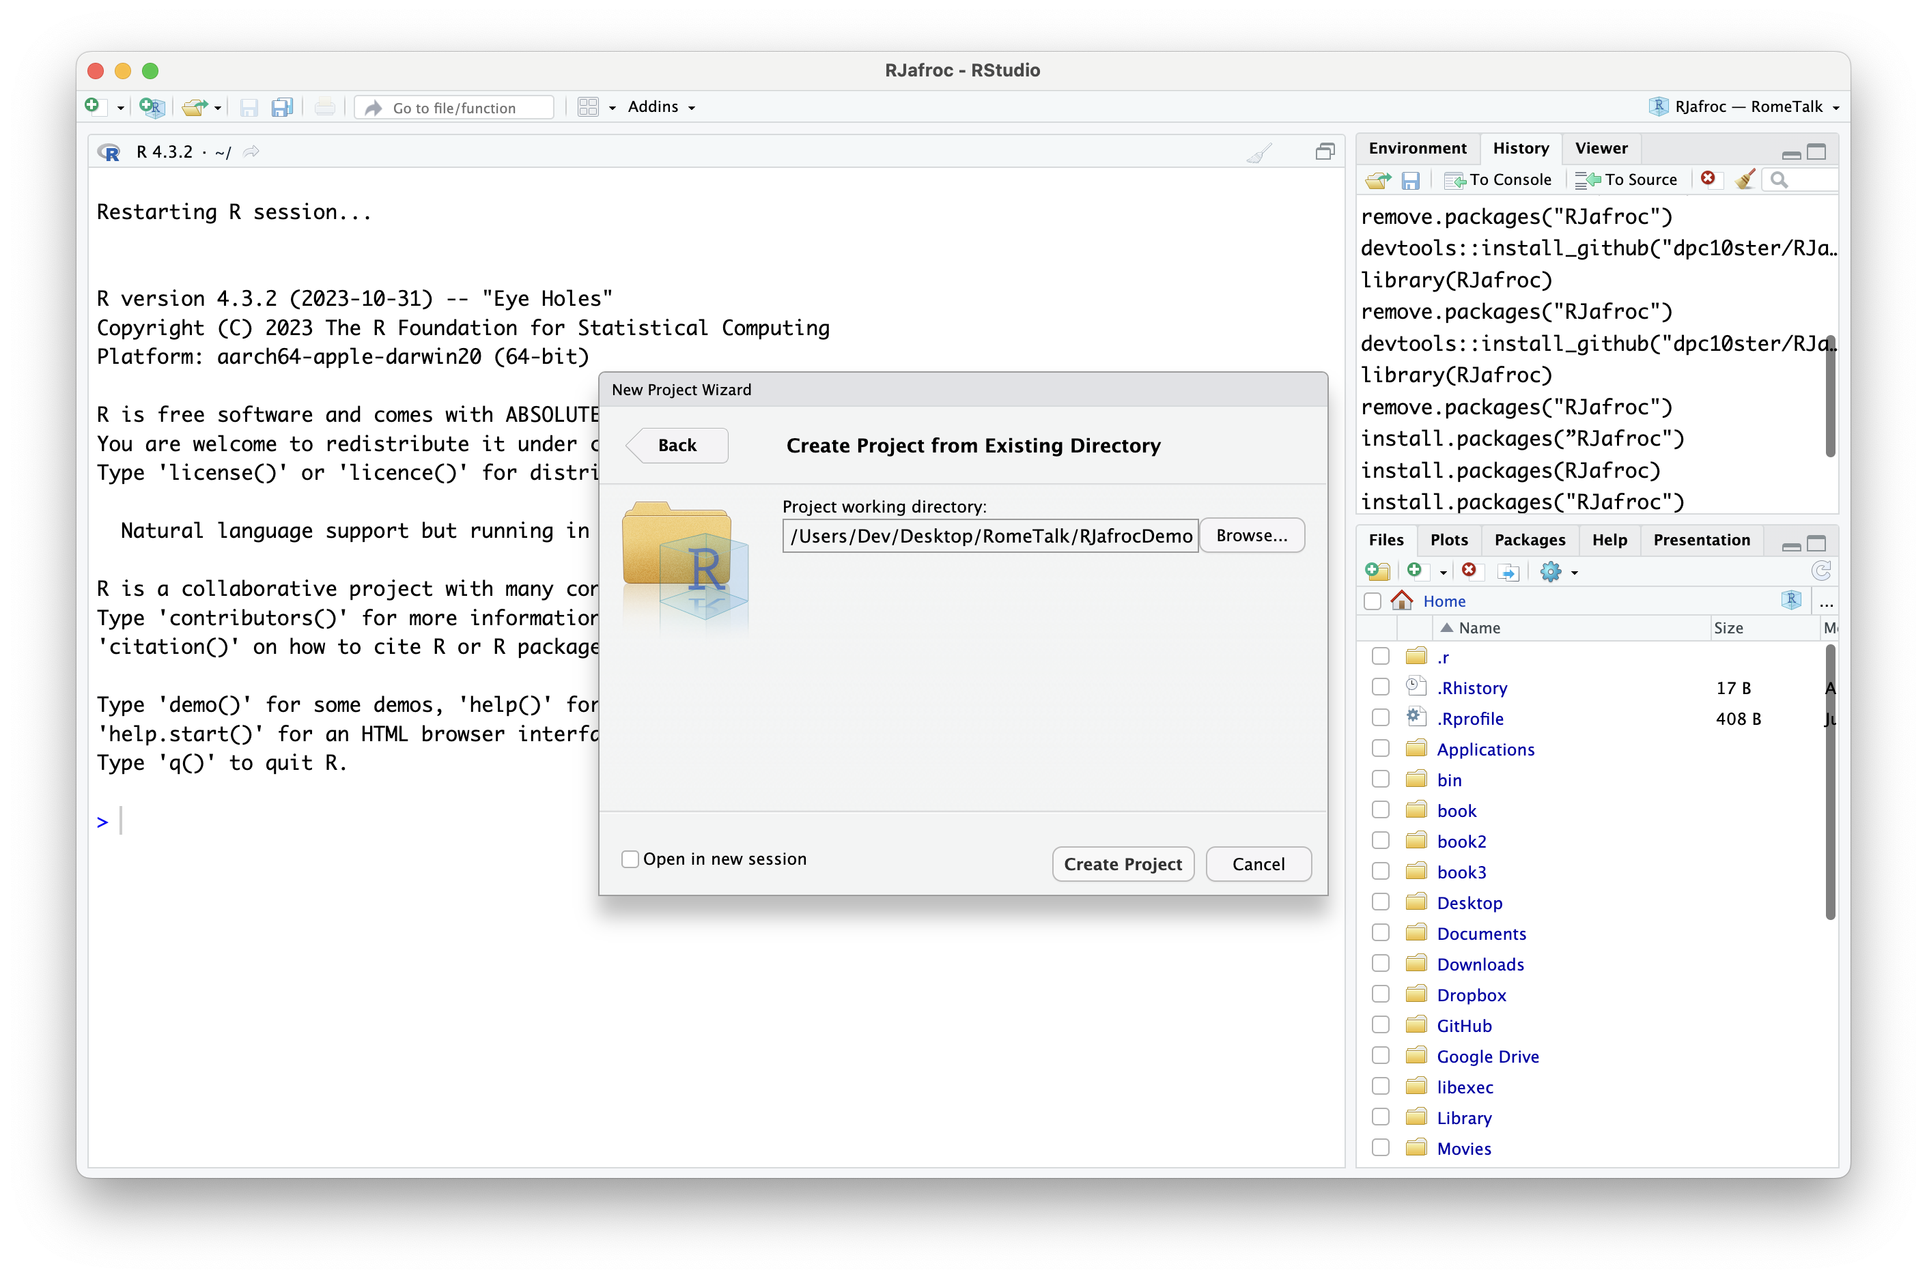
File -> New Project -> Existing Directory -> Browse to RJafrocDemo folder -> Create Project

Slide 44
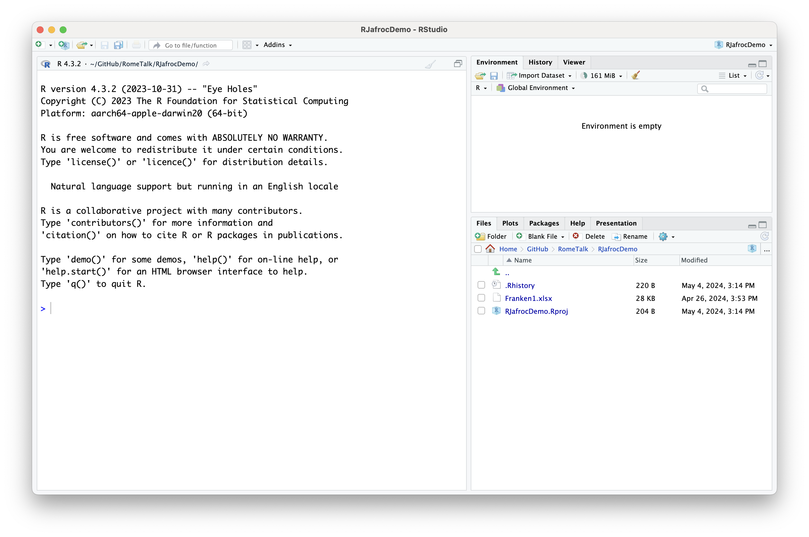

Slide 45
Load RJafroc
install.packages("RJafroc")
library(RJafroc)

Slide 46
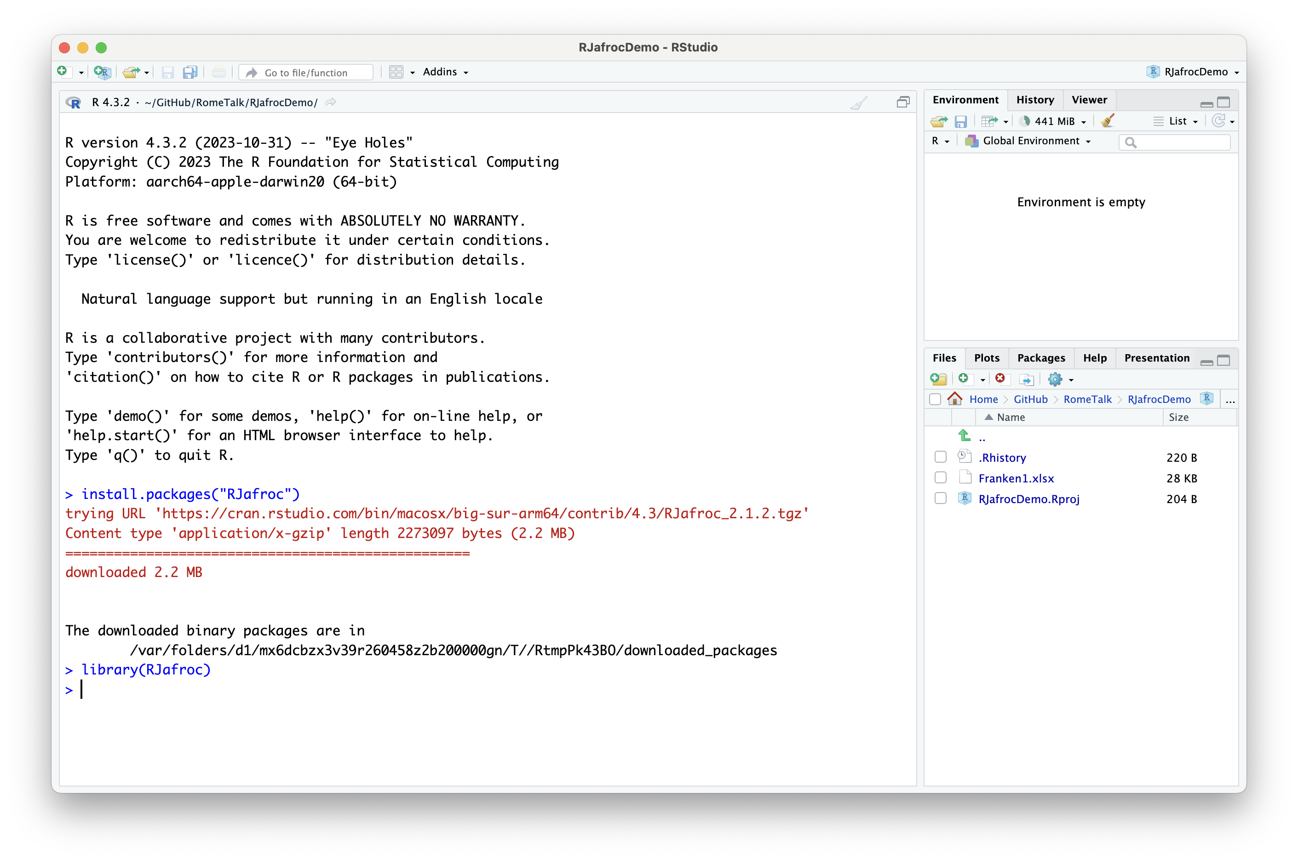

Slide 47
Getting your data into RJafroc
Input Excel file format
https://dpc10ster.github.io/RJafrocQuickStart/quick-start-roc.html#quick-start-roc-excel
Reading the Excel file
https://dpc10ster.github.io/RJafrocQuickStart/quick-start-roc.html#quick-start-roc-read
Analyze dataset
https://dpc10ster.github.io/RJafrocQuickStart/quick-start-or-text.html#quick-start-or-text-analyze-dataset

Slide 48
Read input data file
Franken1.xlsx is an Excel file containing ROC data
Read the file and create dataset object ds
ds <- DfReadDataFile("Franken1.xlsx", newExcelFileFormat = TRUE)
ds contains details about the data

Slide 49
Analyze the dataset
ret <- StSignificanceTesting(ds, FOM = "Wilcoxon")
FOM = figure of merit or performance measure, "Wilcoxon" in this example
Results are contained in ret

Slide 50
View the results

Slide 51
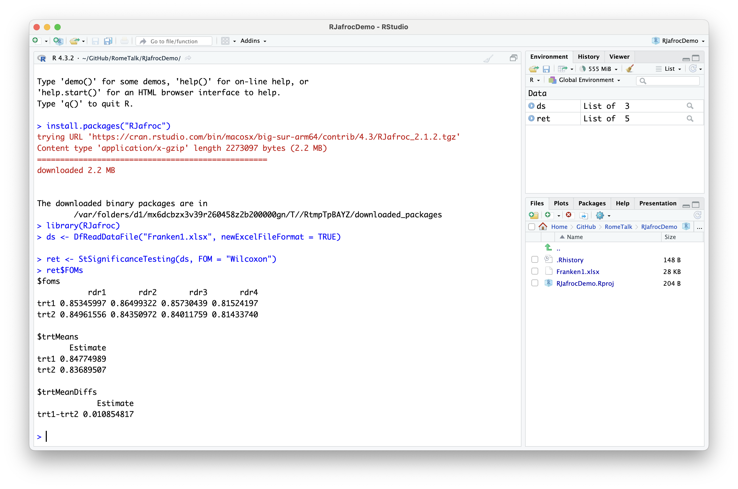
ret$FOM

Slide 52
Three types of randomizations
RRRC = random-reader random-case
results apply to populations of readers and cases
FRRC = fixed-reader random-case
results apply to specific readers and population of cases
RRFC = random-reader fixed-case
results apply to population of readers and specific cases

Slide 53
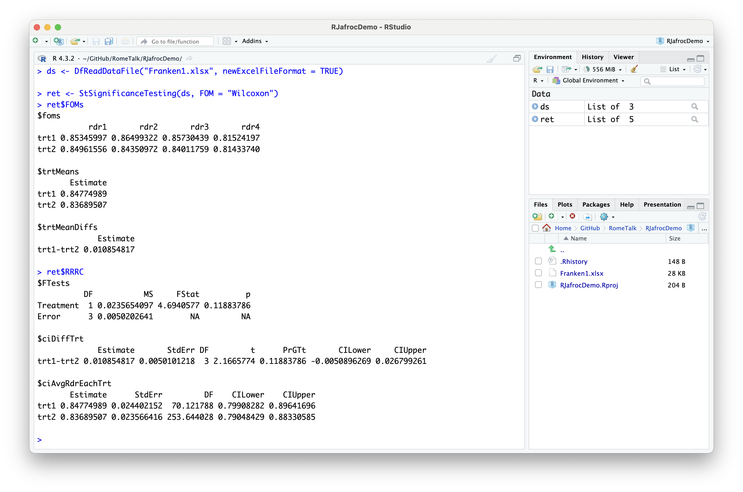
ret$RRRC

Slide 54
My GitHub repositories
Landing page
https://github.com/dpc10ster
Organization of repositories
https://dpc10ster.github.io/ai-froc-research/
Focus on RJafrocQuickStart and RJafrocRocBook:
https://dpc10ster.github.io/RJafrocQuickStart/
https://dpc10ster.github.io/RJafrocRocBook/

Slide 55
END

